Slide 1
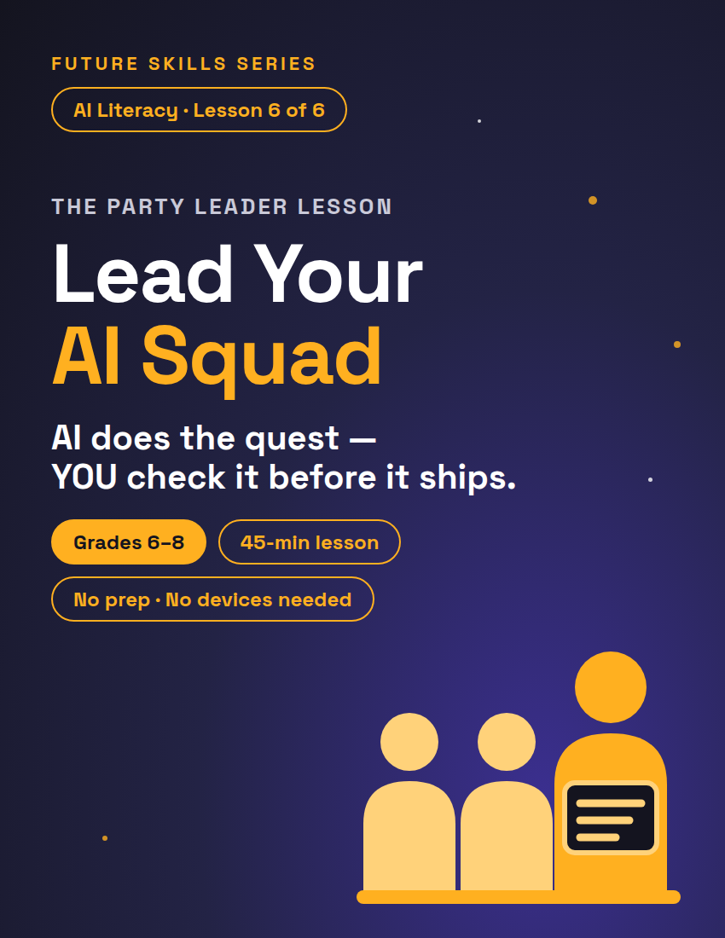
FUTURE SKILLS · AI LITERACY
THE PARTY LEADER LESSON
Lead Your AI Squad
An AI agent does a whole job, step by step, on its own — and if your card leaves something out, the agent usually fills the gap with a guess and keeps going.
1 / 12
Notes:
Open on this slide while students settle. Worksheet: Run the Quest, one per student (3 pages), plus one sheet of scrap paper per student for squad outputs. Plan teams of 3 (30 students = 10 teams; remainder rule is in the Activity notes). Fully unplugged by design. Deck follows the lesson plan block for block; minute chips top-right match it.

Slide 2
FUTURE SKILLS · AI LITERACY
6 MIN
Warm-Up — It Did EXACTLY What You Said
My new party member: maxed-out stats, never sleeps, never complains — painfully literal.
"Guard the door." → Guarded the door. Only the door. The enemies came in through the window.
"Grab everything in the chest." → Everything. Including the cursed amulet with the obvious skull on it.
"Wait here." → Still waiting. It has been three in-game days.
2 / 12
Notes:
Tell the class about last night's run and read the three orders with a straight face. (If your class did the genie lesson, someone will call it: this party member IS the literal genie — it just joined your squad. New classes need no backstory.) WHAT IF nobody laughs: ask for a fourth order from the room and ruin it the same way — "Heal me" → healed you. Once. Then advance to the question.

Slide 3
FUTURE SKILLS · AI LITERACY
Whose fault was that?
?
The party member's — or the orders?
3 / 12
Notes:
Take two or three answers. Bridge: "An AI agent doesn't just answer — it does a whole job in steps: makes a plan, looks things up, uses tools, and hands you a finished thing. Where your quest card is vague, it usually fills the gap with a guess and keeps going. Some tools stop and ask instead. That's why the leader checks. You'll never out-work it. You CAN out-lead it." TRANSITION: "Today you learn the leader's loop: quest card, roles, check the loot — then ship it or run it back. Four parts. Board."

Slide 4
FUTURE SKILLS · AI LITERACY
9 MIN
The Party Leader's Loop
1
2
3
4
Quest Card
Roles
Check the Loot
The Verdict
Leave something out and the party guesses — and you won't know whether it guessed right.
Nobody solos the raid. Split it: a planner, a scout, a critic — same card, one slice each.
The leader checks every output: accuracy, taste, done-ness. Nothing ships unchecked.
SHIP IT (finished and correct — send it) or RUN IT BACK (do it again) + a keep/fix note.
4 / 12
Notes:
Write the loop on the board as you go: QUEST CARD → ROLES → CHECK THE LOOT → SHIP IT or RUN IT BACK. Gloss the two verdicts out loud the first time: SHIP IT = finished and correct, send it; RUN IT BACK = do it again. Each part gets its own slide next; this one is the map.

Slide 5
FUTURE SKILLS · AI LITERACY
The Quest Card — Four Parts, In Writing
G
K
R
D
Goal
What We Know
Rules of the Run
Done Looks Like
What winning means. Not "make a flyer" — "get 6th graders to actually show up."
Who it's for, and what the team already has (time, place, stuff on hand).
The limits: length, tone, deadline. What it must do — and must NOT do.
The exact thing handed back. A flyer draft? A numbered plan? A fact list?
5 / 12
Notes:
(If your class did the genie lesson: this is P.R.O. grown up — Purpose became Goal + What We Know, Requirements became Rules, Output became Done Looks Like.) How to score any quest card: hand it to the most literal reader in the room. If they can twist it, or have to guess, a part is missing or vague. TRANSITION: "Let's build one together."

Slide 6
FUTURE SKILLS · AI LITERACY
Watch one get fixed — "Plan the game night." becomes a quest card
G
K
R
D
Goal
What We Know
Rules of the Run
Done Looks Like
get 6th graders to actually show up to Game Night.
Friday, gym, 6–8 pm; we have board games and two TVs.
school-appropriate, big readable title, 40 words max.
one flyer draft, ready to photocopy.
6 / 12
Notes:
Start with the cursed order — "Plan the game night." — then build the card on the board part by part, labeling each: GOAL, WHAT WE KNOW, RULES OF THE RUN, DONE LOOKS LIKE (same wording as the lesson plan). Ask: what could a literal party member still twist? Anything they name is a missing rule. WHAT IF a student says the card is "too long": count it — four lines. "Four lines now, or a flyer that says 'games all night' later."

Slide 7
FUTURE SKILLS · AI LITERACY
“
Party leaders don't do the quest twice.
If you have to redo a party member's work, your quest card failed. Fix the card, not just the work.
7 / 12
Notes:
Say it plainly: "Party leaders don't do the quest twice. If you have to redo a party member's work, your quest card failed. Fix the card, not just the work." TRANSITION: "Three roles. Same card, one slice each. Here they are."

Slide 8
FUTURE SKILLS · AI LITERACY
Party Roles — Same Card, One Slice Each
P
S
C
Planner
Scout
Critic
0–4 min: a numbered step list. Card silent? Write "NOT ON THE CARD." 4–8 min: a time guess per step; star the riskiest.
0–4 min: list every fact the quest needs; mark each ✓ (say how) or ? (say where). 4–8 min: turn every ? into the one question you'd ask.
0–4 min: write 2 things the audience on the card cares about. 4–8 min: read the Planner's list; write 3 upgrades.
8 / 12
Notes:
KEY — what good output looks like (Game Night card): PLANNER: 1. Pick the games and TV setup (5 min) 2. Write the flyer title and the when/where line (5 min) 3. ★ Add a 40-word pitch (10 min) 4. Count words, check the rules (3 min) 5. NOT ON THE CARD: who photocopies it, and how many? (Minutes 4–8 add the time guesses and the star.) SCOUT: Friday ✓ (on the card) · gym ✓ (on the card) · 6–8 pm ✓ (on the card) · both TVs actually work? ? (ask whoever runs the gym) · how many 6th graders there are ? (the front office). CRITIC: minutes 0–4, what the audience cares about: which games, and whether friends are going. Upgrades: (1) Put the TVs and the games in the title — 6th graders come for the games, not the date. (2) Cut the 40 words to 25; nobody reads a wall of text on a wall. (3) Add one line for parents: pick-up is at 8. Paper logic: papers never move mid-round; at the 4-minute call the Critic reads the Planner's list over their shoulder. ROTATION: Sit in a triangle. The Scout sits on the Planner's left; the Critic sits on the Scout's left. Every paper moves one seat to its owner's left — the Planner's plan goes to the Scout, the Scout's questions go to the Critic, the Critic's list goes to the Planner. Coaching: the planner's NOT ON THE CARD flags are gold — they're the next card's fixes. A scout's fact with no "how we know" is a guess wearing a costume. Vague praise from a critic doesn't count. TRANSITION: "Page 1. Pick your quest. ONE card per team: the card-holder writes all four parts, everyone copies GOAL and DONE LOOKS LIKE. Eight minutes."

Slide 9
FUTURE SKILLS · AI LITERACY
24 MIN
Activity — Run the Quest
1
Write the quest card · 8 min
Teams of 3. Pick a quest. ONE card per team: the card-holder writes all four parts; the others copy GOAL and DONE LOOKS LIKE.
2
Squad works · 8 min
Now switch: YOU play an AI agent. Take a role card; work SILENTLY on a blank sheet — not this worksheet. No questions: agents can't read minds.
3
Leader review · 8 min
Every paper moves one seat to its owner's left. CHECK rubric: SHIP IT or RUN IT BACK per row, then the note — and hand the paper back.
9 / 12
Notes:
WRITE THE CARD — WHAT IF a team stalls on GOAL: "What would make you say we won?" TRANSITION at 8 min: "Cards done. For 8 minutes YOU play an AI agent. Take a role card. Silence starts now." SQUAD WORKS — in Sana's squad: DeShawn plans, Lucia scouts, Sana critiques. Papers never move mid-round. At the 4-minute call: "Critics, read your Planner's list over their shoulder — 3 upgrades. Planners, add a time guess to every step and star the one most likely to go wrong." Enforce the silence — when a party member asks a question mid-round, answer: "It's not on the card." The frustration is the point. Don't rescue a weak card; the review makes the failure visible and fixable. WHAT IF the class doesn't divide by 3: team of 4 = two critics (both read the plan); team of 2 = drop the critic, the leader does the taste check. 30 students = 10 teams. TRANSITION at the swap: "Time. Sit in a triangle. The Scout sits on the Planner's left; the Critic sits on the Scout's left. Every paper moves one seat to its owner's left — the Planner's plan goes to the Scout, the Scout's questions go to the Critic, the Critic's list goes to the Planner. Keep your worksheet — you're the leader again, page 2." LEADER REVIEW — with that seating, Lucia (Scout) reviews DeShawn's (Planner) plan, Sana (Critic) reviews Lucia's facts, DeShawn reviews Sana's upgrades: the Critic never re-reviews the Planner's list. Each leader quotes ONE line of evidence for the row they mark RUN IT BACK, plus KEEP and FIX; in the last 60 seconds they hand the paper back and read the FIX line to its owner. WHAT IF a leader turns harsh: KEEP comes before FIX, and they read the note aloud to their party member. Next slide stays up during the review.

Slide 10
FUTURE SKILLS · AI LITERACY
Check the Loot
ACCURACY — Does every fact match the card? Is every ✓ backed by a "how we know"?
TASTE — Does it fit the audience and tone on the card, or could it be for anyone at all?
DONE-NESS — Is everything the card asked for actually here?
Each row: SHIP IT (finished and correct — send it) or RUN IT BACK (do it again). Quote the evidence.
Run-it-back note: KEEP (what works and why) → FIX (the exact change + why)
10 / 12
Notes:
Leave this up during Leader review. "Read it like your name is on it — because it is." KEY — a filled CHECK row (Lucia reviewing DeShawn's planner list): ACCURACY — SHIP IT: "Steps 1–4 use Friday, gym, 6–8 pm straight off the card." TASTE — RUN IT BACK: "Step 3 says 'write the pitch' but never says to 6th graders — it could be for anybody." DONE-NESS — SHIP IT: "All four card parts are covered, and the NOT ON THE CARD flag is a plus." Exemplar note — KEEP: "Every step has a time guess and all four card parts are covered." FIX: "Step 3 needs the words 'for 6th graders' — the card names the audience and the plan dropped it." WHAT IF a leader turns harsh: KEEP before FIX, read aloud. Last 60 seconds of the block: hand the paper back and read your FIX line to its owner. TRANSITION: "Loot checked. Last quest: one for your own life. Page 3."

Slide 11
FUTURE SKILLS · AI LITERACY
6 MIN
Exit Ticket — Quest Card for a Real Task
1. Write a quest card for one real task in YOUR life this week (a study plan, a chore list, a team flyer): GOAL · WHAT WE KNOW · RULES OF THE RUN · DONE LOOKS LIKE.
2. Which role gets it first? Check one, then write why: Planner · Scout · Critic
3. Which check would it most likely fail? Check one, then write what you'd look for: Accuracy · Taste · Done-ness
11 / 12
Notes:
Worksheet p.3, solo, 6 minutes. Collect. KEY — #1 exemplar (study plan): GOAL: pass Friday's fractions quiz with at least a B. WHAT WE KNOW: 7th grade math; I have the review sheet and 30 minutes a night, Monday to Thursday. RULES OF THE RUN: only fractions with different denominators, no calculators, nothing due before Wednesday. DONE LOOKS LIKE: a four-night plan, 5 practice problems a night with answers on a separate line. Test: could a stranger do it tomorrow from the card alone? Scoring: Proficient = all four parts labeled and specific; Developing = parts present but vague ("make it good," "soon"); Beginning = a wish, not a quest card ("help me with math"). #2: any role with a reason tied to the task (scout for a fact-heavy flyer; planner for a schedule) — the reason is what scores. #3: any check with something real to look for ("accuracy — the quiz date"; "done-ness — did it give all four nights?"). WHAT IF a student writes a wish: "Which part is missing? Add the one that would stop a stranger from guessing." Sentence starters for support: Teacher Guide, p.1.

Slide 12
FUTURE SKILLS · AI LITERACY
Your party is tireless. The name on the quest is YOURS.
A good AI job runs human → AI → human: you write the card, the AI does the middle, you check the loot. If wrong facts ship, the leader said yes to it.
12 / 12
Notes:
Close on this — it's the leader rule from the bottom of the worksheet. This is Lesson 6 of 6 (Lesson 6 — in the unit bundle, or sold separately); the unit ends here, and every lesson stands alone. (If your class did the earlier lessons: the quest card is the genie-proof prompt, the accuracy check is the fact desk, the taste check is the feedback eye — they had the skills; today they found out the skills make them a leader.) With devices: the five-line block in the lesson plan runs one team's card on your projected account and the class checks its output with the same rubric. Hedge if asked about jobs: AI agents take over tasks, not whole jobs — nobody can promise the final count.

